Slide 1
Secure your Home client presentation
SMART MINDS:
Leigha Ifiyemi
Abubakar Nafaty
Buhari Aliyu
Asmau Aminu
Sakshi Kumari
Ravi Kiran PP
Yuvasri Balu

Slide 2
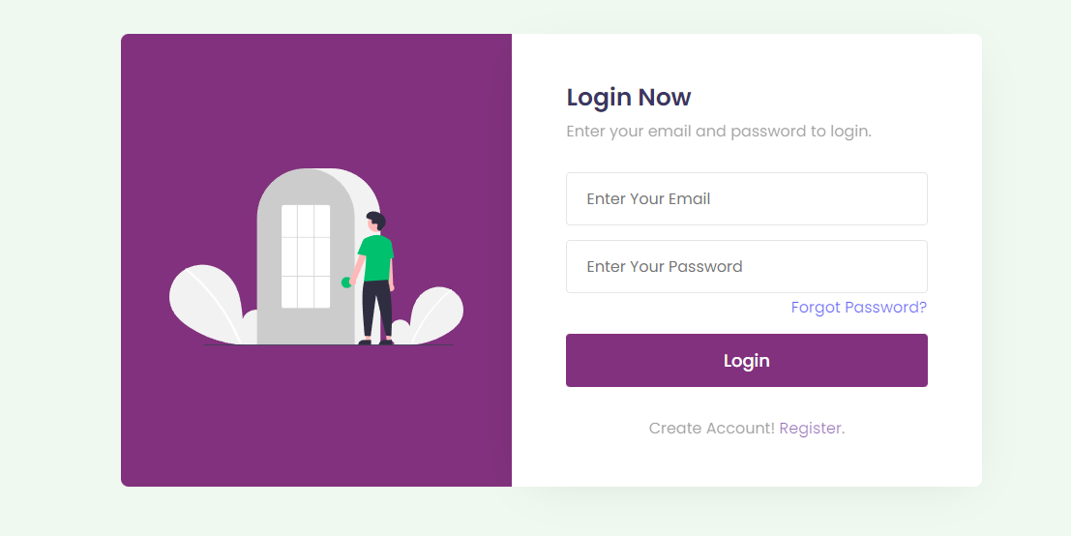
Login Page

Slide 3
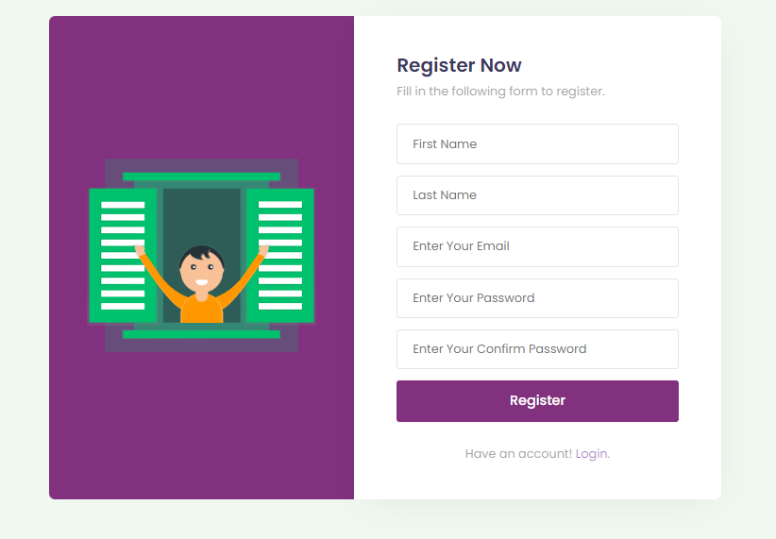
Customer Register Page

Slide 4
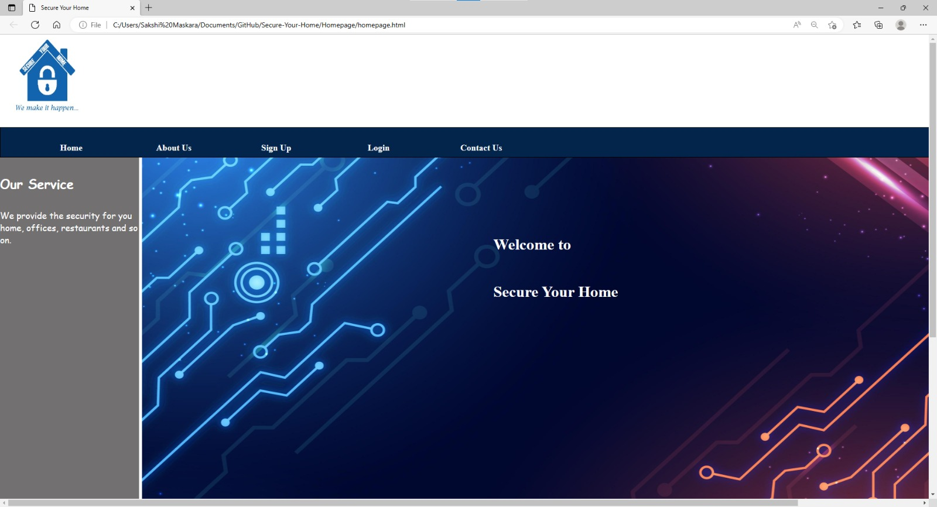
Home Page

Slide 5
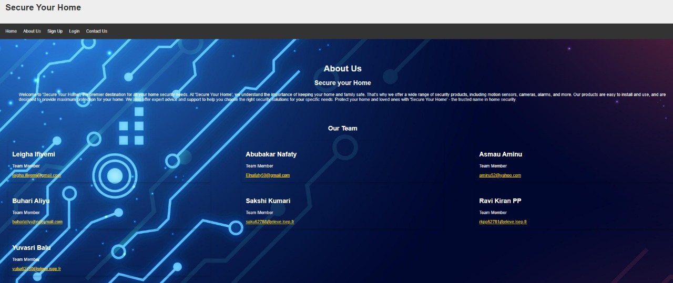
About Us Page

Slide 6
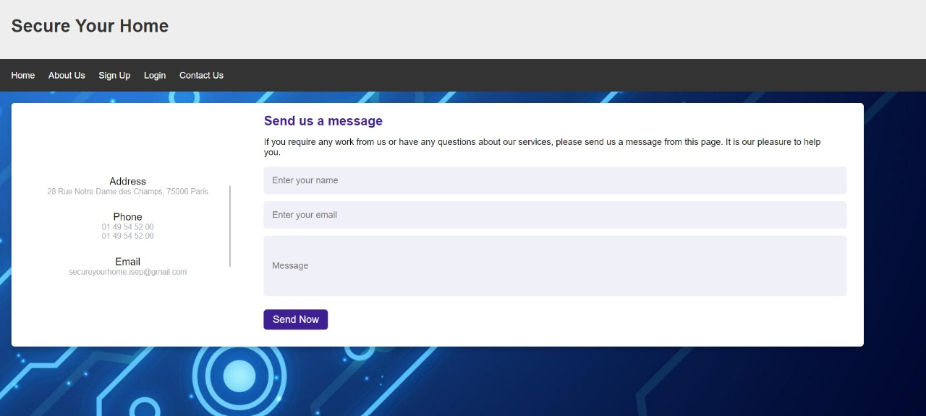

Slide 7
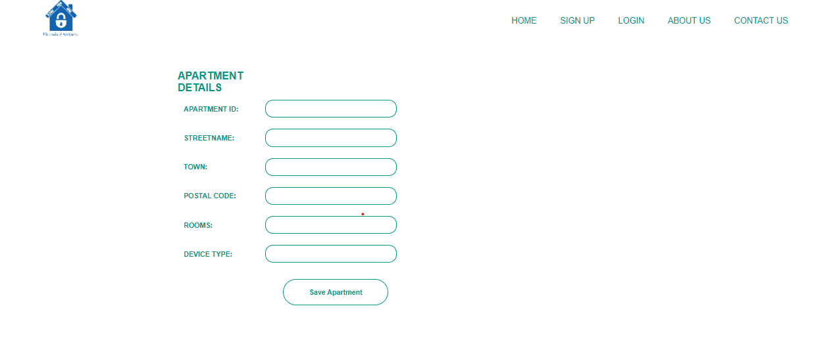

Slide 8
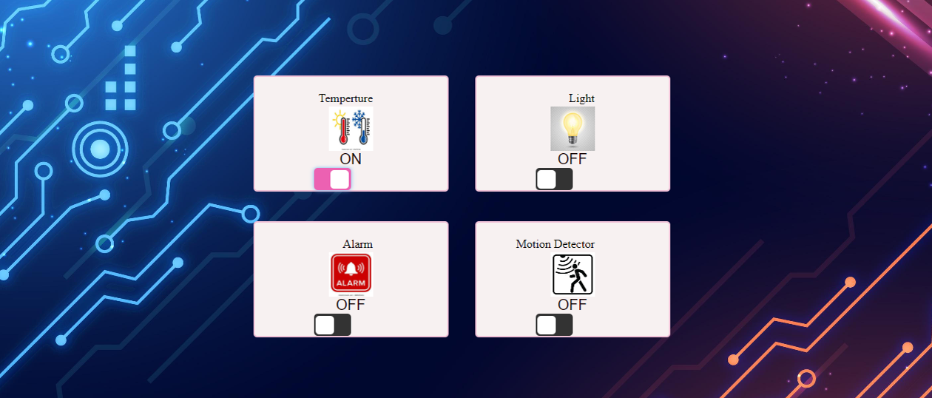
Control Device

Slide 9
GANTT CHART
Smart Home Solutions System (Project Schedule) |  |  |  |  |  |  |  |  |  |  |  |  |  |  |  |  |  |  |  |  | 06/10/2022 |  |  |  |  |  | 1/01/2023 |  |  |  |  |  | 03/01/2023
PROJECT NAME |  |  |  |  |  |  |  |  |  |  |  |  |  |  |  |  |  |  |  |  | START DATE |  |  |  |  |  | END DATE |  |  |  |  |  | LAST UPDATE DATE\
Task ID | Task Name | Start Date | End Date | % Completed | 07/10/2022 | 08/10/2022 | 09/10/2022 | 10/10/2022 | 09/10/2022 | 12/10/2022 | 13/10/2022 | 14/10/2022 | 17/10/2022 | 18/10/2022 | 19/10/2022 | 20/10/2022 |  |  |  |  |  |  |  |  |  |  |  |  |  |  |  |  |  | 01/01/2023 | 03/01/2023
1 | Team Name and Logo | 07/10/2020 | 09/10/2022 | 100%
2 | Team Charter | 07/10/2020 | 10/10/2022 | 100%
3 | App Importance | 2/10/2020 | 10/10/2022 | 100%
4 | Use case Diagram | 2/10/2020 | 19/10/2022 | 100%
5 | MOCKUP | 09/10/2022 | 13/10/2022 | 90%
6 | GANTT | 9/10/2020 | 19/10/2022 | 60%
7 | Specification | 12/10/2020 | 19/12/2020 | 100%
8 | Activity Diagram | 12/10/2022 | 19/10/2022 | 100%
9 | Navigation Diagram | 12/10/2022 | 19/10/2022 | 100%
10 | Presentation to Client | 20/10/2022 | 20/10/2022. | 100%
11 | ER Diagram | 07/11/2022 | 14/11/2022 | 100%
12 | Mapping | 07/11/2022 | 14/11/2022 | 100%
13 | Database | 07/11/2022 | 10/11/2022 | 95%
14 | HTML & CSS | 14/11/2022 | 21/11/2022 | 80%
15 | Website design | 20/11/2022 | … | 70%
16 | Implementation | 20/11/2022 | …. | 40%
17 | Client presentation | 15/12/2022 | 15/12/2022 | ……
 | Report submission
 | Conclusions and results
 | Final Report
Remarks:

Slide 10
Thank You ☺….

